Slide 1
Training for the annual submissions to the DOE Technical Standards Program on your organization’s development and use of Voluntary Consensus Standards
The Department prepares an annual report to the Office of Management and Budget (OMB) on Federal Participation in the development and Use of Voluntary Consensus Standards and in Conformity Assessment Activities.

Slide 2
Templates and forms for submissions
Record of Non-Government Standards Activity, Organization/Bulk Individual Submission TEMPLATE
This template is used to submit standards activity for an individual. You may submit as many individual templates as needed. You may have participants in your organization that submit an individual form to you. You can submit their individual form as well as a bulk form for the rest of the participants.
Record of Non-Government Standards Activity, Organization/Bulk Submission TEMPLATE
This template is used to submit standard activity data for an entire organization.
DOE F 1300.2, Record of Non-Government Standards Activity FORM
An alternate form located on the Energy.gov website is used for submitting records of non-government standards activity
Newly Adopted Non-Government Standards TEMPLATE
This template is used to submit information for standards adopted and used by your entire organization.

Slide 3
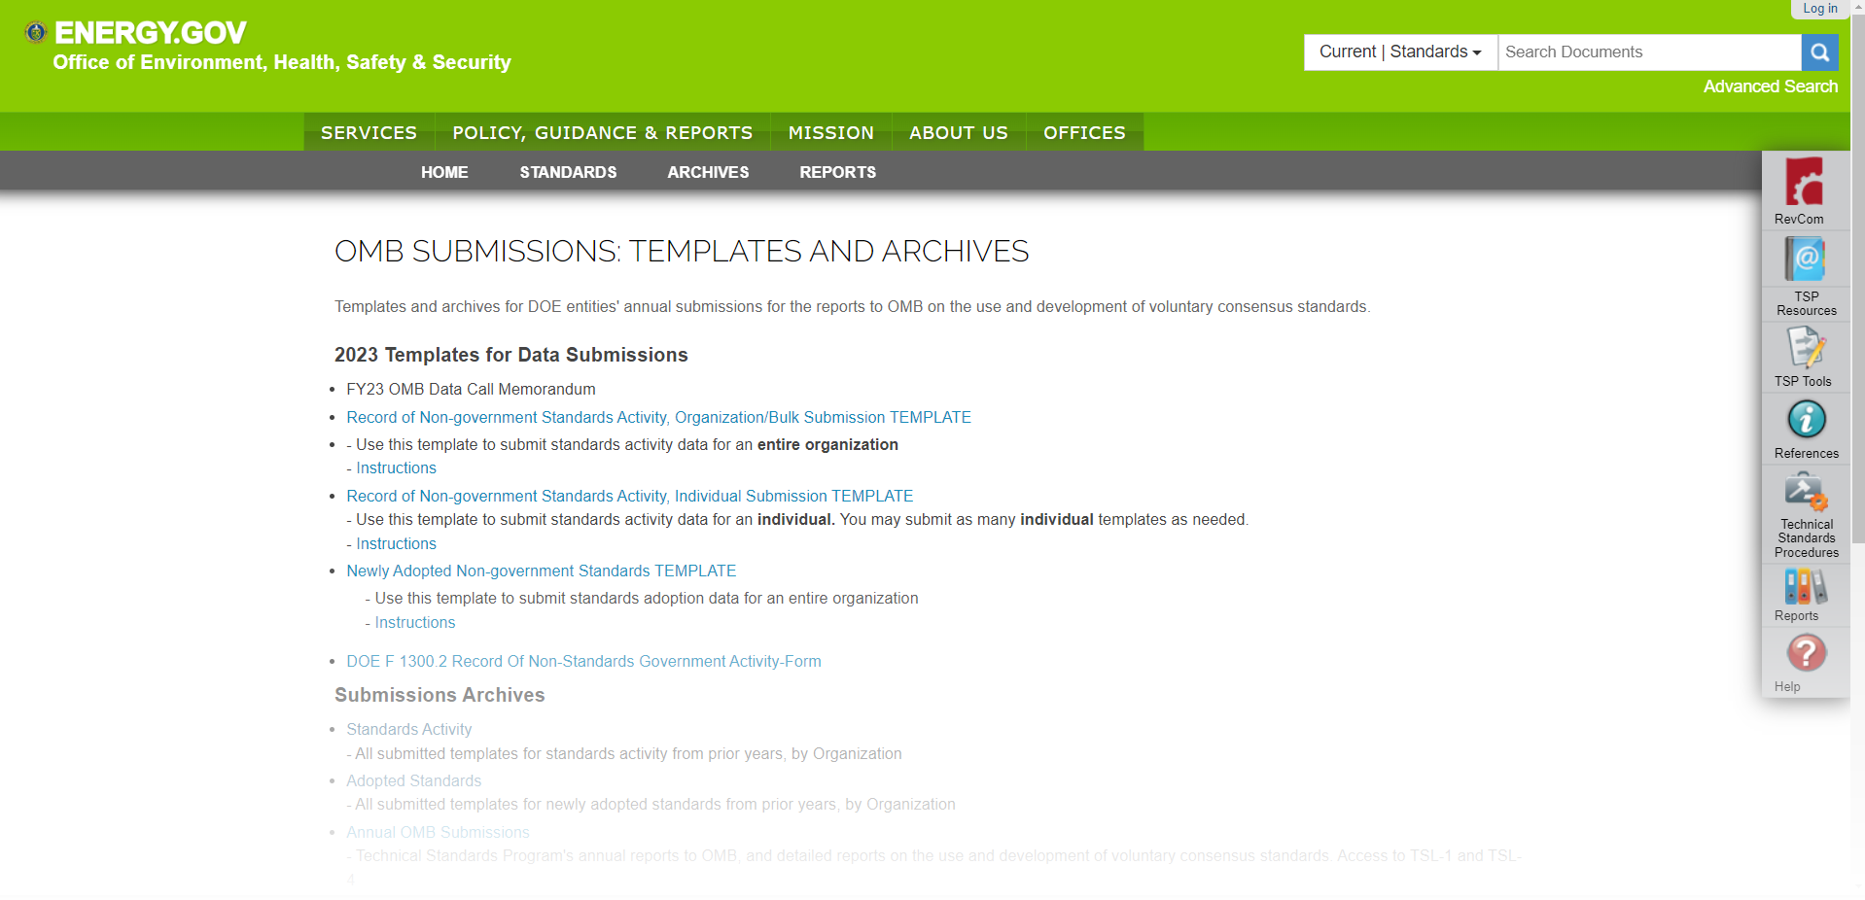
All the templates mentioned can be found at https://www.standards.doe.gov/omb-submissions/omb-submissions-templates-and-archives

Slide 4
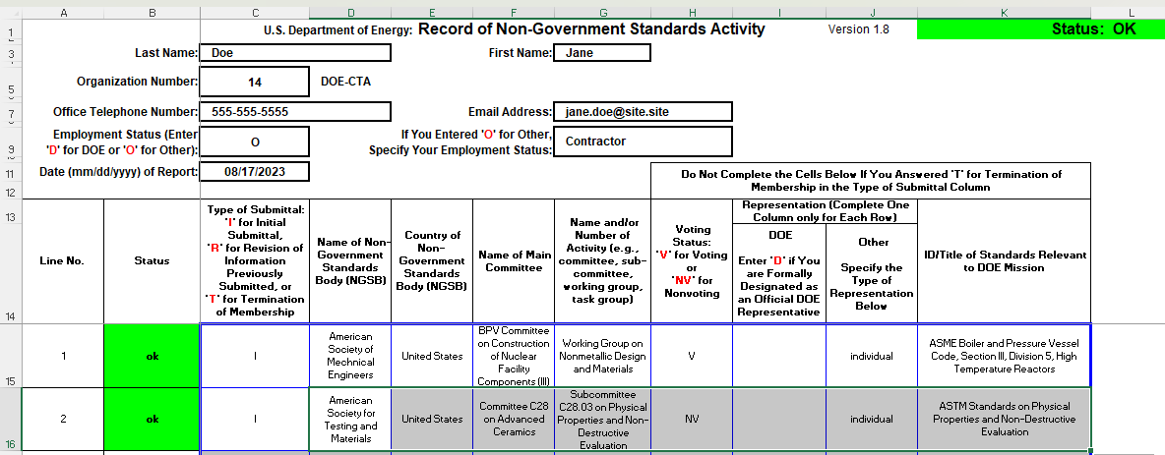
Individual Templates for Non-Government Standards Activity
If you are submitting data for yourself, you will need to complete this form including all the data for the non-government standards committees, working groups, or task groups.
When the information is filled in correctly you will see the status information in the top right corner “Status: OK” in green which means you have completed the form with no errors.

Slide 5
Bulk Submission for Non-Government Standards Activity
If you are submitting data on behalf of your organization’s participants you will need to complete this form including all the data for the non-government standards committees, working groups, or task groups.
When the information is filled in correctly you will see the status information in the top right corner “Status: OK” in green which means you have completed the form with no errors.

Slide 6
Newly Adopted Non-Government Standards -- Template
Data for any New Adopted Non-Government Standards that are being used by your organization will be entered on the form below.
When the information is filled in correctly you will see the status information in the top right corner “Status: OK” in green which means you have completed the form with no errors.

Slide 7
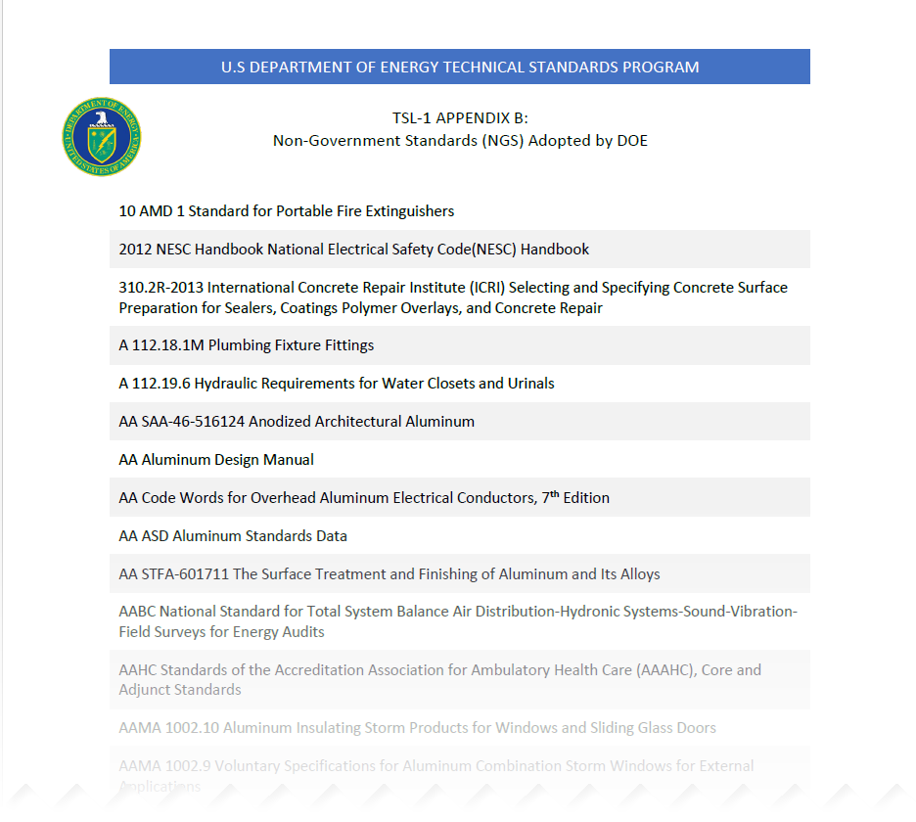
Once all the information has been collected from the various organizations for the Non-Government Standards that have been adopted the data is compiled and added to TSL-1 Appendix B – Non-Government Standards (NGS) Adopted by DOE.

Slide 8
Missing information or errors
Information missing in the submitter information.
When you have missing submitter information in the template you will notice that the missing information cell will be yellow in the top blue box in columns M, N, and O indicating missing or incorrect submitter information. Once the data missing information has been input the cell will no longer be yellow and the blue box will be gone.

Slide 9
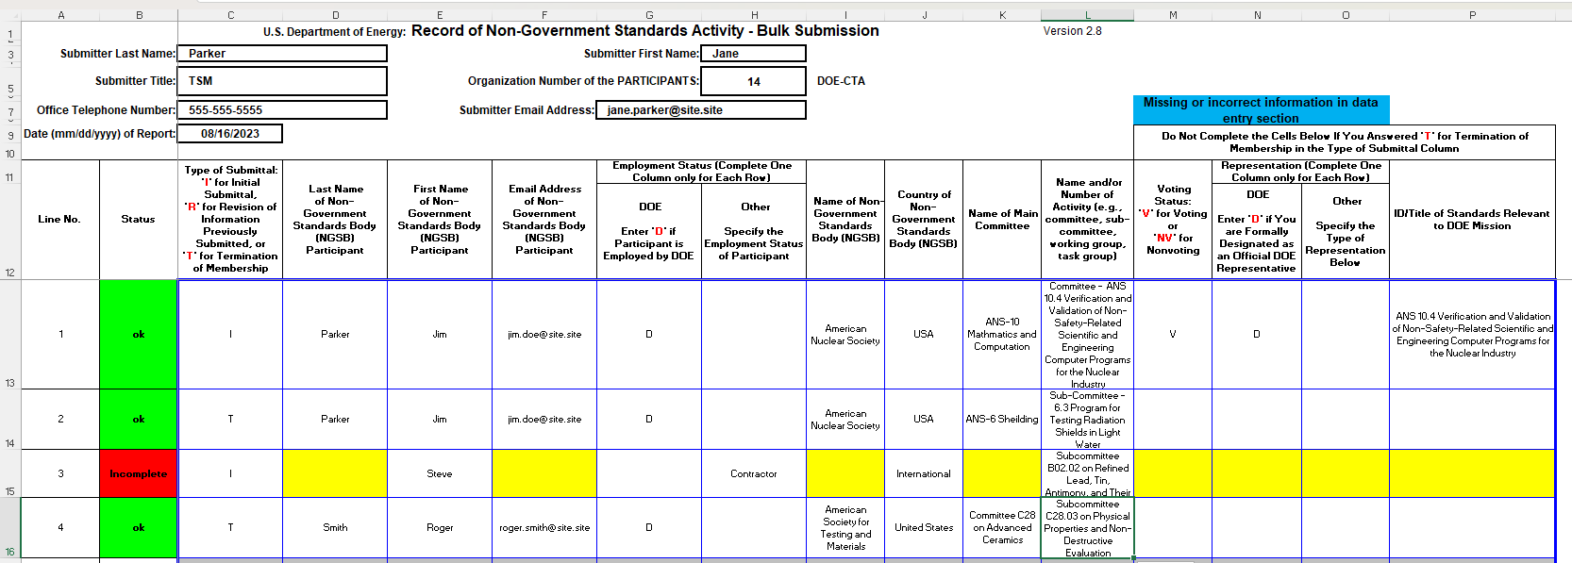
Missing information or errors
Information missing in the data entry section
When you have missing information in the body of the template you will notice that there will be the word incomplete in red in column B and there will be a blue box in columns M, N, and O that indicates missing or incorrect information in the data entry screen

Slide 10
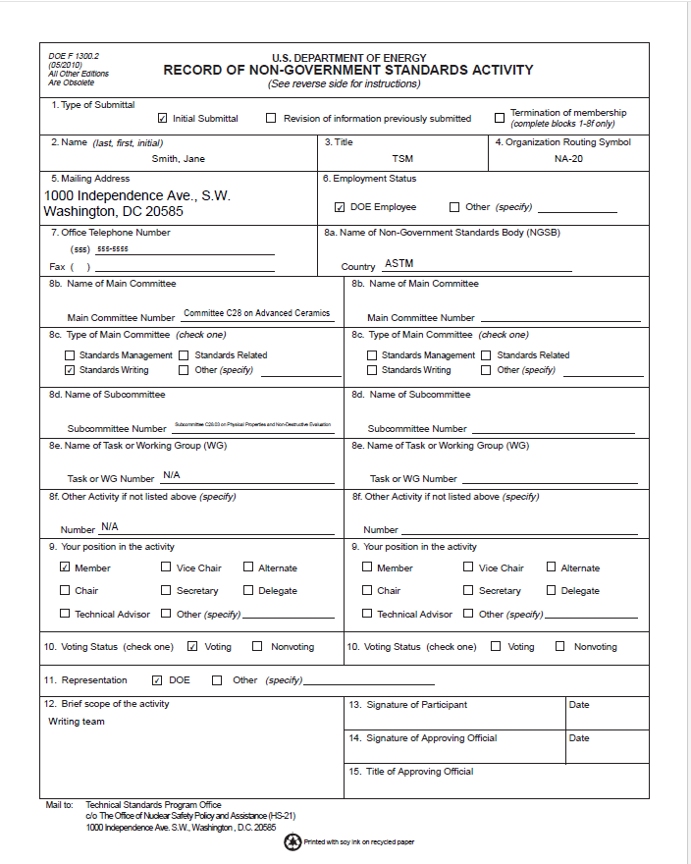
Form DOE F 1300.2
Form DOE F 1300.2 is an alternate form that can be filled out and submitted by the participant. This form will need to be signed and scanned in before submission. The same information in the templates are collected in the form.

Slide 11
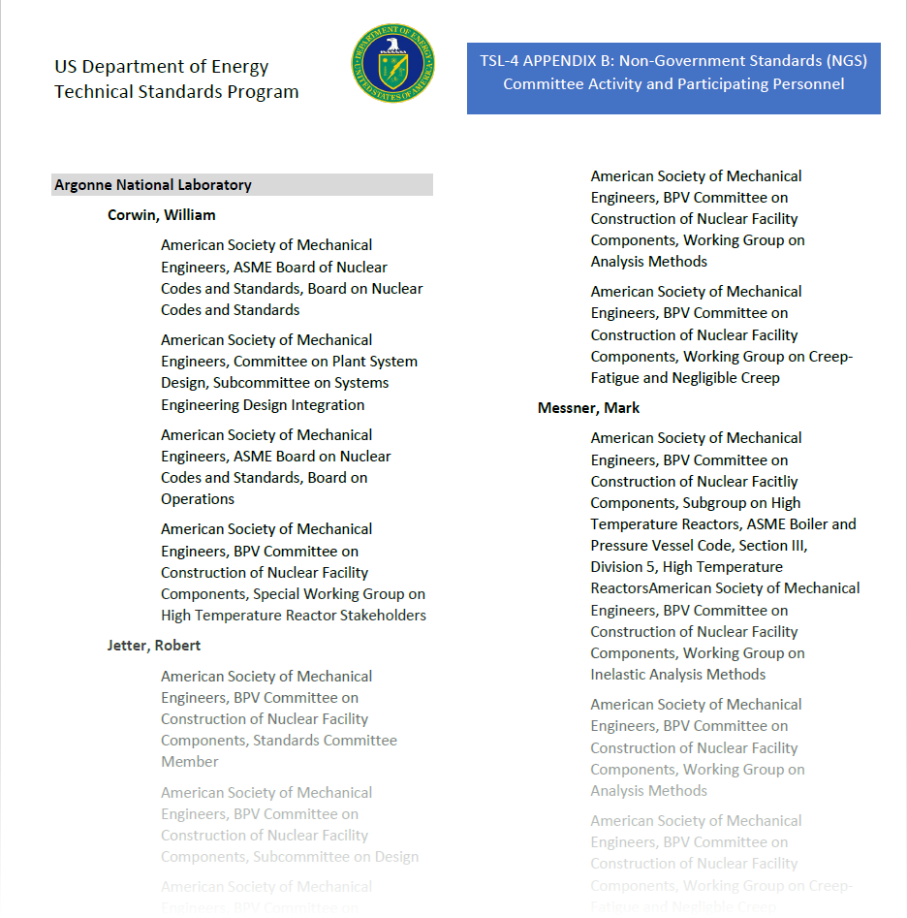
Once all the information has been collected from the various organizations for the Non-Government Standards Activities the data is compiled and added to TSL-4 Appendix B – Non-Government Standards (NGS) Committee Activity and Participating Personnel

Slide 12
Questions

